Slide 1
Have You Prepared Your Business for the Next Disaster
Louisiana Emergency Management Conference
May 10, 2023

Slide 2
What is the LABEOC
The Louisiana Business Emergency Operations Center started in 2006 in the aftermath of Katrina
Located at the Informatics Research Institute in the UL Research Park
  Abdalla Hall – 50,000 sq. ft. facility
  Collocated with NIMSAT, NSF CVDI, and NASA RAC
Focuses on helping private sector entities (Businesses and VOADs) prepare for and recover from disasters, natural or man-made
Notes:
Good evening ladies and Gentlemen. ___________ Thank you for the nice introduction. As mentioned I am Jim Williams, the Operations Officer for the Louisiana Business Emergency Operations Center. While I am fairly new to the position, starting the Monday before hurricane Laura hit, I am not new to emergency operations in Louisiana. Since joining the Louisiana National guard after serving in the 82nd Airborne Division, I have been involved in the response to almost every major emergency operations in the state, except the ones that occurred while I was deployed, namely Hurricane Katrina and Deep Water Horizon. The BEOC was started after the devastation of hurricane Katrina. There were a lot of efforts focused on helping citizen recovery, but not a lot focused on getting business back on their feet. The BEOC mission has never changed since it’s inception, helping business prepare for and recover from natural and man-made disasters. Since approximately 2016 the BEOC has been located on the campus of the University of Louisiana at Lafayette and additional serves as a back-up operations center for GOHSEP should the Baton Rouge office become inoperable.

Slide 3
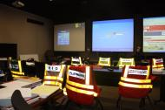
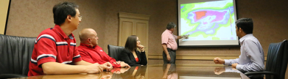
What is the LABEOC
Conducts research outside of hurricane season in support of emergency management subjects
During Emergency Operations LABEOC opens communications between public and private sector to:
  Provide Information
    Feedback on business status
  Obtain Information
    Road closures / curfews / utility status
  Identify obstacles
    What keeps you from reopening
  Build Resilience
    Support local economies through network of associations
Notes:
Good evening ladies and Gentlemen. ___________ Thank you for the nice introduction. As mentioned I am Jim Williams, the Operations Officer for the Louisiana Business Emergency Operations Center. While I am fairly new to the position, starting the Monday before hurricane Laura hit, I am not new to emergency operations in Louisiana. Since joining the Louisiana National guard after serving in the 82nd Airborne Division, I have been involved in the response to almost every major emergency operations in the state, except the ones that occurred while I was deployed, namely Hurricane Katrina and Deep Water Horizon. The BEOC was started after the devastation of hurricane Katrina. There were a lot of efforts focused on helping citizen recovery, but not a lot focused on getting business back on their feet. The BEOC mission has never changed since it’s inception, helping business prepare for and recover from natural and man-made disasters. Since approximately 2016 the BEOC has been located on the campus of the University of Louisiana at Lafayette and additional serves as a back-up operations center for GOHSEP should the Baton Rouge office become inoperable.

Slide 4
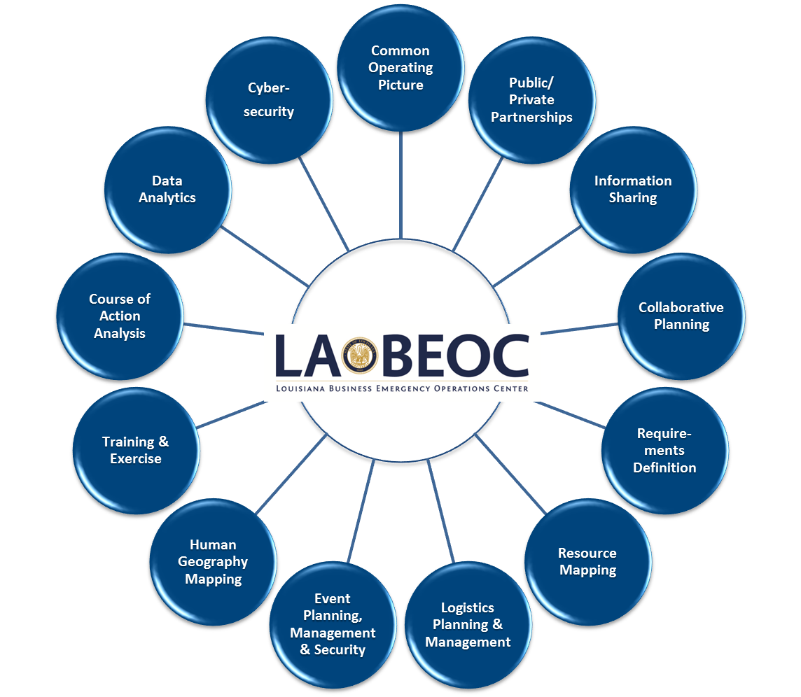
Research on / Research with

Slide 5
Why the LABEOC
Dollars Drive Recovery
  #1 Personal Income
    Citizen-Focused
    Return to Normal
  Business Income
    10-Day Failure Rule
  Tax Revenue
Avoid Duplication of Effort
Everyone is invested in Recovery
Notes:
Good evening ladies and Gentlemen. ___________ Thank you for the nice introduction. As mentioned I am Jim Williams, the Operations Officer for the Louisiana Business Emergency Operations Center. While I am fairly new to the position, starting the Monday before hurricane Laura hit, I am not new to emergency operations in Louisiana. Since joining the Louisiana National guard after serving in the 82nd Airborne Division, I have been involved in the response to almost every major emergency operations in the state, except the ones that occurred while I was deployed, namely Hurricane Katrina and Deep Water Horizon. The BEOC was started after the devastation of hurricane Katrina. There were a lot of efforts focused on helping citizen recovery, but not a lot focused on getting business back on their feet. The BEOC mission has never changed since it’s inception, helping business prepare for and recover from natural and man-made disasters. Since approximately 2016 the BEOC has been located on the campus of the University of Louisiana at Lafayette and additional serves as a back-up operations center for GOHSEP should the Baton Rouge office become inoperable.

Slide 6
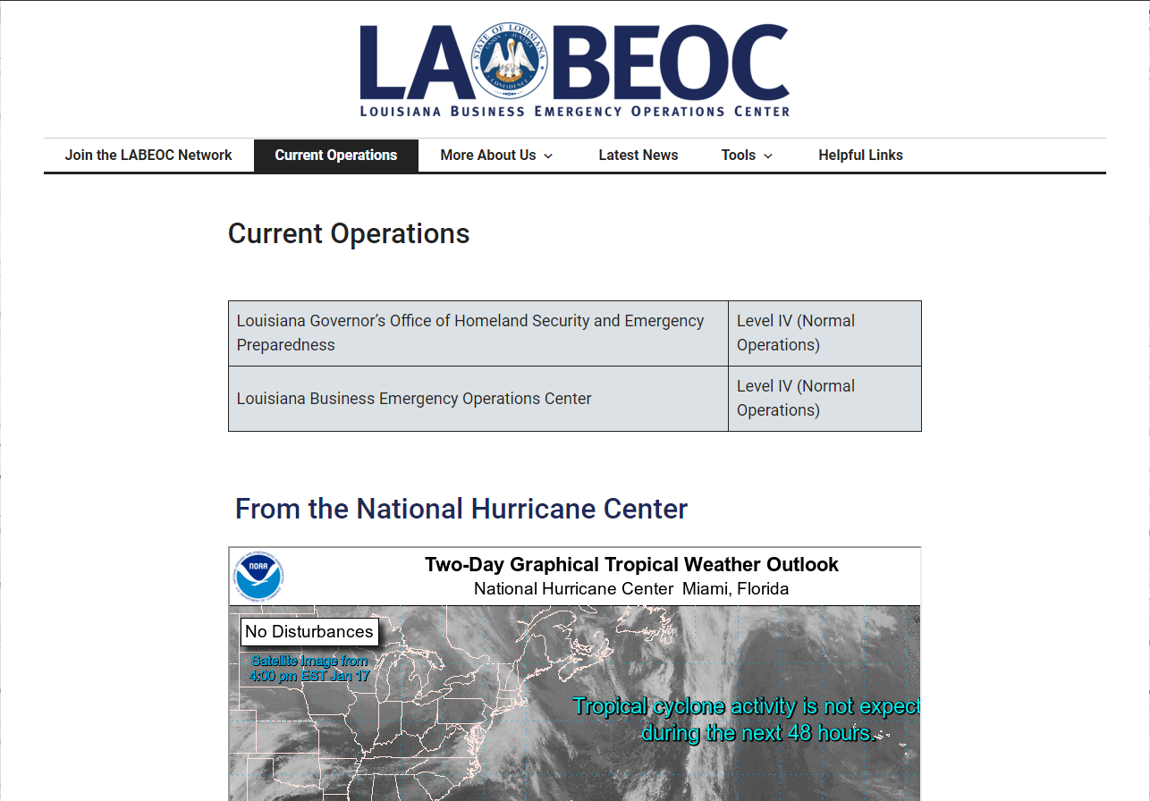
Why the LABEOC
Market Indicators
  Retail / Grocery
  Fuel
  Power
  Lodging
  Supply Chain Access
Situational Awareness
  Identifying information needs
  Data display examples
Connecting Dots
  Resource location
  Need identification
Notes:
Good evening ladies and Gentlemen. ___________ Thank you for the nice introduction. As mentioned I am Jim Williams, the Operations Officer for the Louisiana Business Emergency Operations Center. While I am fairly new to the position, starting the Monday before hurricane Laura hit, I am not new to emergency operations in Louisiana. Since joining the Louisiana National guard after serving in the 82nd Airborne Division, I have been involved in the response to almost every major emergency operations in the state, except the ones that occurred while I was deployed, namely Hurricane Katrina and Deep Water Horizon. The BEOC was started after the devastation of hurricane Katrina. There were a lot of efforts focused on helping citizen recovery, but not a lot focused on getting business back on their feet. The BEOC mission has never changed since it’s inception, helping business prepare for and recover from natural and man-made disasters. Since approximately 2016 the BEOC has been located on the campus of the University of Louisiana at Lafayette and additional serves as a back-up operations center for GOHSEP should the Baton Rouge office become inoperable.

Slide 7
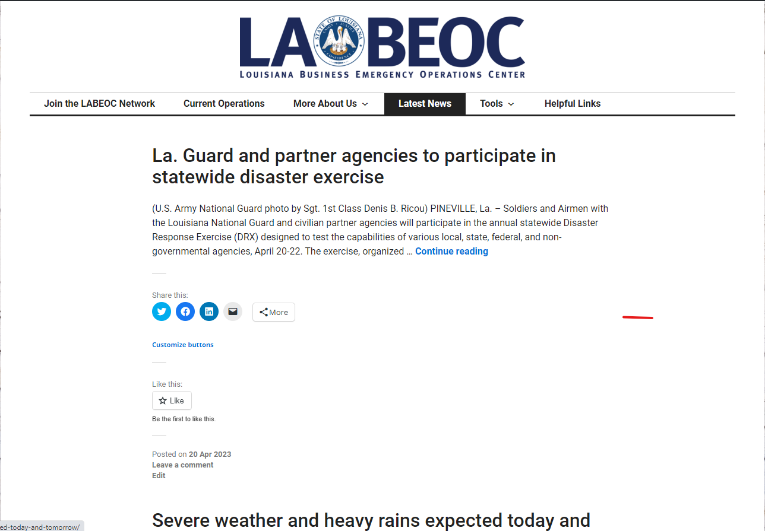
Why the LABEOC
Stakeholder Associations:
Association of Contingency Planners
Associated Wholesale Grocers
Associated Grocers
Baton Rouge Area Foundation
LA VOAD
Louisiana Credit Union League
Louisiana Hotel and Lodging Association
Louisiana Motor Transport Association
Louisiana Office of Financial Institutions
Louisiana Oil Marketers and Convenience Store Association
Louisiana Pulp and Paper Association
Louisiana Restaurant Association
Louisiana Retailers Association
Louisiana Telecommunications Association
Louisiana Mid-Continent Oil & Gas Association (LMOGA)
Louisiana Association of Business and Industry
Louisiana Bankers Association
Louisiana Chemical Association
Louisiana Hospital Association
Louisiana Technology Council
National Federation of Independent Business
Ports Association of Louisiana
Notes:
Good evening ladies and Gentlemen. ___________ Thank you for the nice introduction. As mentioned I am Jim Williams, the Operations Officer for the Louisiana Business Emergency Operations Center. While I am fairly new to the position, starting the Monday before hurricane Laura hit, I am not new to emergency operations in Louisiana. Since joining the Louisiana National guard after serving in the 82nd Airborne Division, I have been involved in the response to almost every major emergency operations in the state, except the ones that occurred while I was deployed, namely Hurricane Katrina and Deep Water Horizon. The BEOC was started after the devastation of hurricane Katrina. There were a lot of efforts focused on helping citizen recovery, but not a lot focused on getting business back on their feet. The BEOC mission has never changed since it’s inception, helping business prepare for and recover from natural and man-made disasters. Since approximately 2016 the BEOC has been located on the campus of the University of Louisiana at Lafayette and additional serves as a back-up operations center for GOHSEP should the Baton Rouge office become inoperable.

Slide 8
Hurricane Ida
During Emergency Operations, collocate with GOHSEP for the first 72 hours
Provided the Governor’s office with critical visibility of affected industries
Provided Situational Awareness to National Business EOC, FEMA partners, and the private sector for community lifelines and subsequent actions
Member of LA Fuel Task Force
  Assisted in the resolution of Fuel shortage
  Mobilized over 175 tankers from across the U.S. to support the fuel supply chain
  Made recommendations for generator support to affected communities
  Made recommendations to Fuel VOAD for location and resupply
Louisiana Department of Wildlife and Fisheries Support
  Submitted recommendations for support to the seafood industry
    Ice Houses
    Docks
    Fuel sites
Notes:
You have spent a lot of time, sweat, tears, and blood to make your business successful. Make sure you protect it just like you would your own home.
Make sure you have an updated inventory of all assets and equipment the business owns. The best way to do that is with the smartphone in your pocket or maybe on your table.
Consider how you will safeguard any hazardous chemicals your business utilizes, if applicable
72 hours is a good rule of thumb for loss of electricity whether at home or at work. As recent storms have shown, our increasingly aging infrastructure is vulnerable. Some communities in Cameron and Calcasieu were without power for much as 14 to 30 days after hurricane Laura
As always, monitor what your local officials are saying concerning storm path and intensity. When in doubt use the “Jim” rule. Not me, but if Cantore shows up in Destrehan, New Orleans, or Morgan City, it’s probably not a good thing.

Slide 9
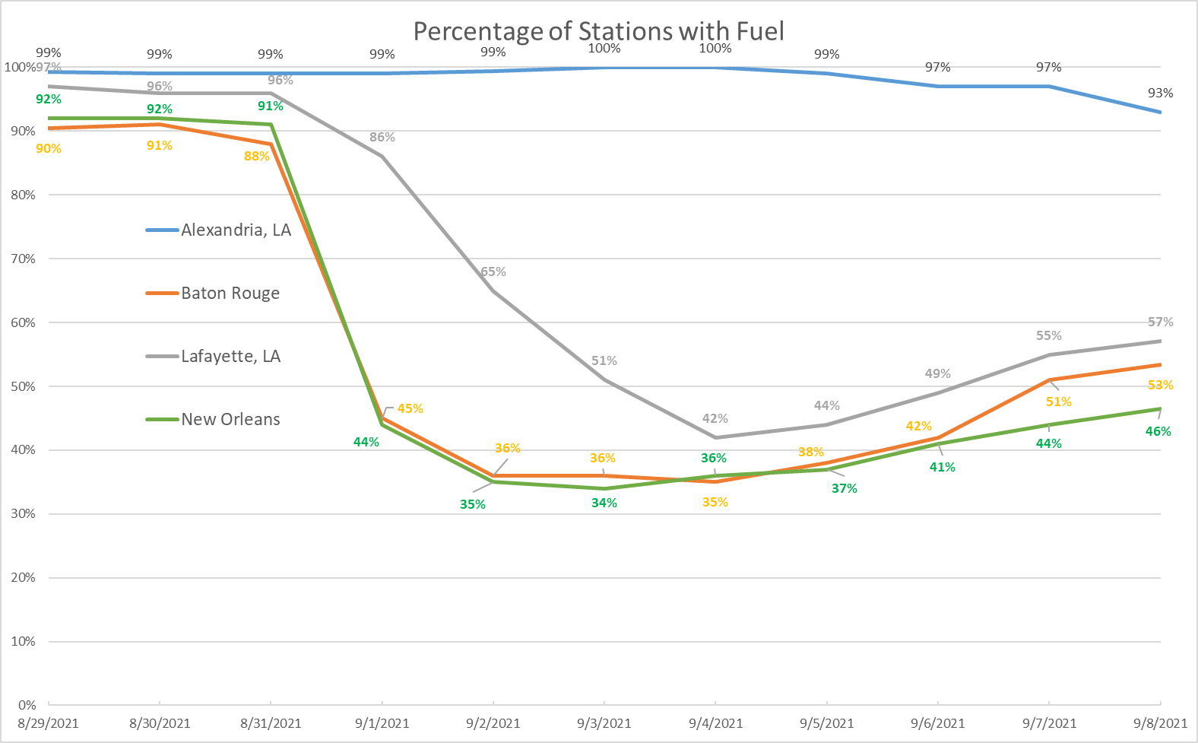
Hurricane Ida Gas Station Trend by Metro Area
LABEOC / NBEOC
As of 6:00 pm 9/8/21
Ida Landfall

Slide 10
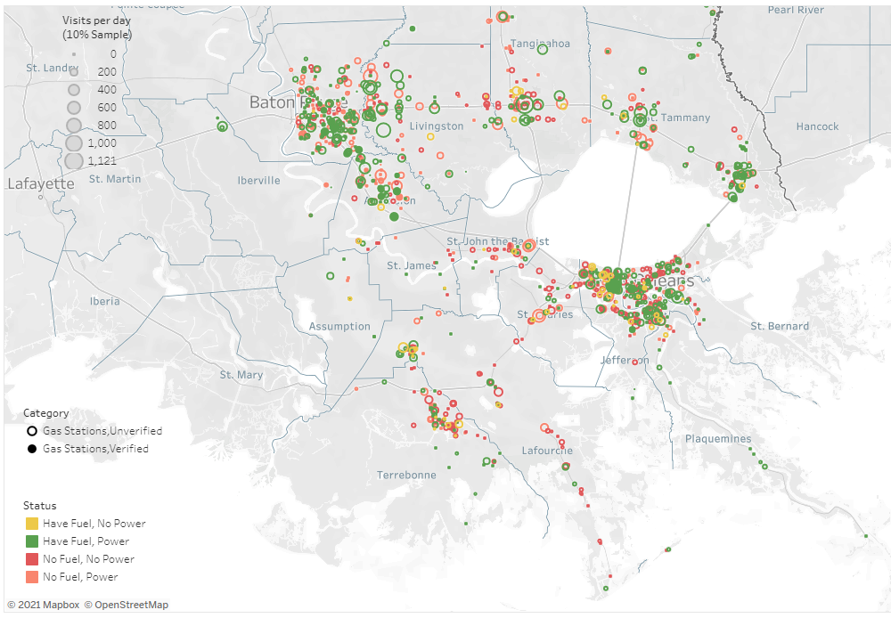
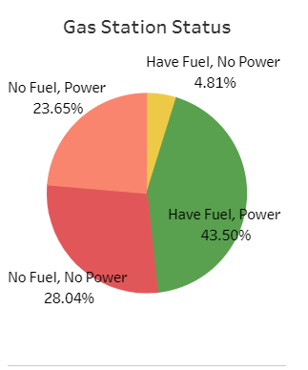
Hurricane Ida Gas Station Situational Awareness
LABEOC / NBEOC
As of 6:00 pm 9/8/21
http://IdaFuel.vastream.net/

Slide 11
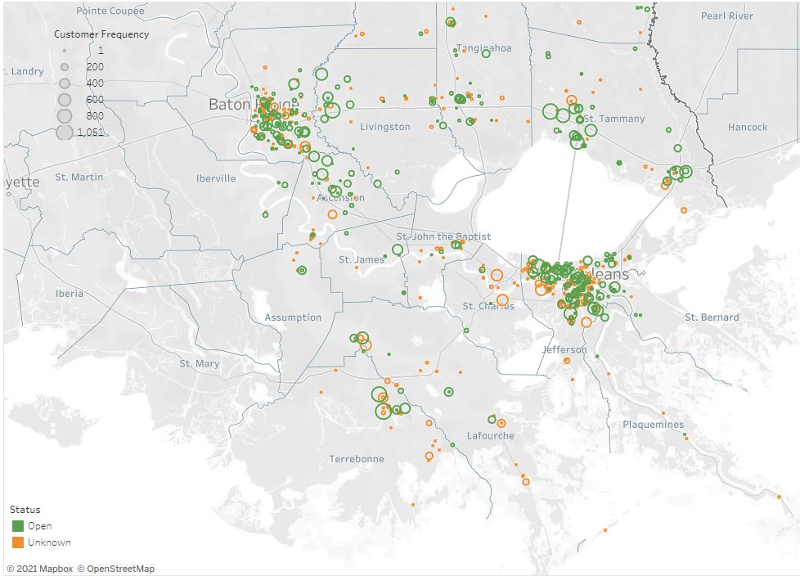
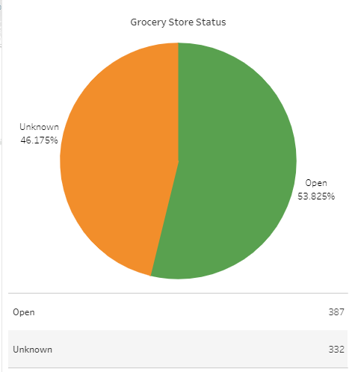
Hurricane Ida Grocer Store Situational Awareness
LABEOC / NBEOC
As of 6:00 pm 9/8/21
http://idagroceries.vastream.net/

Slide 12
Disaster Preparedness
GENERAL
Have a plan to stay in business
  Continuity of Operations Plan (COOP)
    Isn’t just for hurricane season
    know the threats to your business
    Cover financial planning into continuity
    “Rainy Day” fund
    Risk Assessments
      Most Dangerous vs. Most Likely
  Review insurance coverage
    Know your named storm deductible
    Flood Insurance
    Inquire about cyber insurance
Notes:
With June 1st being the official beginning of the 2021 hurricane season, there is no better time to talk about preparations. Now all of you here are obliviously smart business men and women, so you know how to be in business. You know what makes things tick and have planned for being in business. Disaster preparedness is no different. You first started with a business plan or an idea, in a disaster you have to have a plan, so plan to stay in business. Small business owners should call in the trusted advisors and develop a continuity of operations plan. This COOP will help you no matter if it’s a hurricane, flood, ice storm, whatever. With your team evaluate the natural and man-made disasters that can threaten your business and how to mitigate them. IN this area in particular you may have to consider how an emergency at another business may affect your business, like a chemical leak etcetera.
Do not forget to cover financial planning in this COOP. IF you haven’t talked to your insurance agent lately it’s not too late. Remember most policy changes have a 30 waiting period so this is something that you really need to get in front of.
Always listen to your local leaders for official information concerning local preparations.
I believe that people are your most important resource. Make sure your employees have an emergency plan. Know how to communicate with your employees if/when they evacuate. Have redundancy in communication channels

Slide 13
Disaster Preparedness
GENERAL
Be informed
  monitor local situations
Be prepared
  Know what kinds of emergencies and effect your business; conduct a risk assessment
  Make sure employees have a plan
Talk
  communicate with your employees
  involve them in the continuity planning process
See www.ready.gov/business for additional resources
Notes:
With June 1st being the official beginning of the 2021 hurricane season, there is no better time to talk about preparations. Now all of you here are obliviously smart business men and women, so you know how to be in business. You know what makes things tick and have planned for being in business. Disaster preparedness is no different. You first started with a business plan or an idea, in a disaster you have to have a plan, so plan to stay in business. Small business owners should call in the trusted advisors and develop a continuity of operations plan. This COOP will help you no matter if it’s a hurricane, flood, ice storm, whatever. With your team evaluate the natural and man-made disasters that can threaten your business and how to mitigate them. IN this area in particular you may have to consider how an emergency at another business may affect your business, like a chemical leak etcetera.
Do not forget to cover financial planning in this COOP. IF you haven’t talked to your insurance agent lately it’s not too late. Remember most policy changes have a 30 waiting period so this is something that you really need to get in front of.
Always listen to your local leaders for official information concerning local preparations.
I believe that people are your most important resource. Make sure your employees have an emergency plan. Know how to communicate with your employees if/when they evacuate. Have redundancy in communication channels

Slide 14
Disaster Preparedness
CYBER
It is always CYBER season
On average a hacker strikes every 39 seconds*
23% of all Americans have been a victim of cyber attack*
43% of all malicious attacks are directed at small business*
What can you do?
  DO NOT OPEN suspicious emails
  Keep virus protection updated
  Utilize Virtual Private Networks (VPN)
  Use strong passwords (12 characters or more)
  Change passwords often (minimum every 6 months)
  Use firewalls
  Disconnect from the internet when not in use
  Back up data often
  Cyber insurance policy
If attacked, consider reporting to:
  LSPs LA-SAFE – Louisiana - State Analytical and Fusion Exchange
  FBIs internet crime complaint center (IC3) at www.ic3.gov
* Source – ic3 2018 annual report
Notes:
As we take this time to prepare for hurricane season, I would be delinquent to not mention to you that it is always cyber season. In the 2018 K3 report, and I know that this is dated, but absolutely relevant, that a cyber attacks occurs on average every 39 seconds. 23% of ALL Americans have been victims of some type pf cyber attack, whether that is as simple your Facebook account being hacked, or as serious as identity theft, cyber attack is real, and according to Secretary of Commerce Gina Raimondo in an interview on June 6, 2021 she believes that cyber attacks are not only here to stay, but are likely to increase in the near future.
You may ask yourself, I’m not an IT guy or gal, so what can I do? Listed here are some very simple ways to help protect yourself and your business…
If you are a victim of cyber attack, the Louisiana State Police has a cyber task force that can and will do forensics to determine where and how the criminals got in, so by all means report these crimes. I will caution that, if you have a cyber insurance policy, make sure that you know what is covered by them and what their procedures may be.

Slide 15
Business Preparedness
RECOVERY
After the disaster
  FEMA = individual (employees) and government entities
  SBA = small business
SBA disaster loans
  Must be federal declared disaster
  Maximum of $2 million
  Repair or replace
    Real property, Machinery, equipment, fixtures, Inventory, Leasehold improvements
  www.disasterloanassistance.sba.gov
“Recovery is Economic Development”
Notes:
There are no magic bullets in physically recovering from a disaster, but having a plan will help.
According to the Bureau of Labor and Statistics, 96% of business that have a disaster plan will recover.
The most important take away in the recovery phase is to remember that FEMA is there to help individuals recover
The Small Business Administration is there to help provide low interest business loans to help business recover. Once the federal disaster is declared, this will allow the SBA to make disaster recovery loans available.

Slide 16

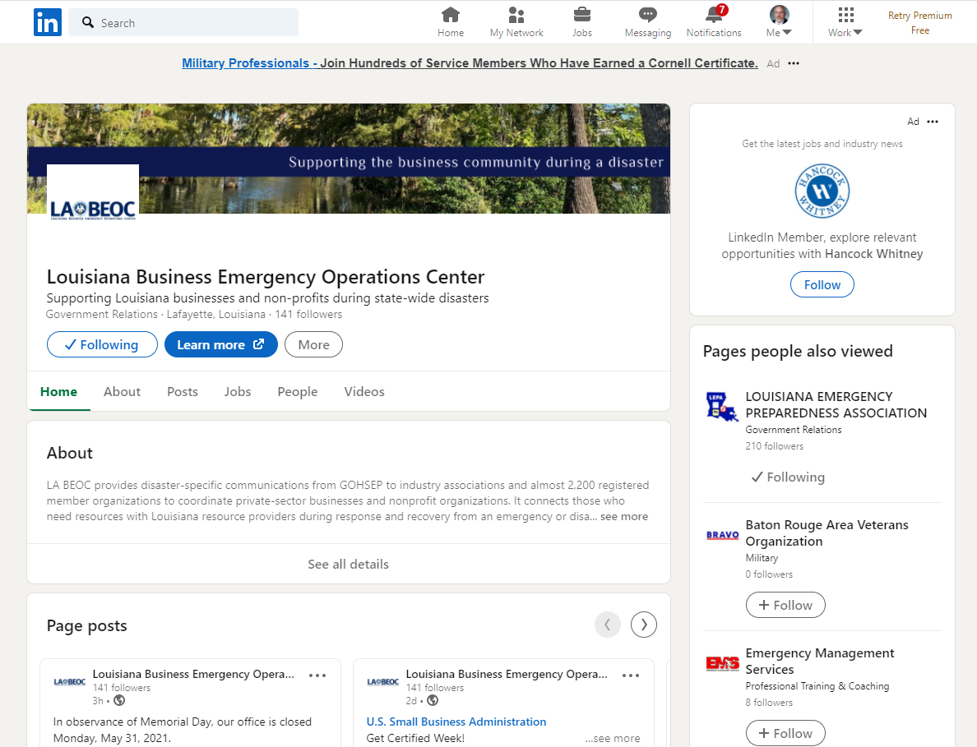


Resources
LABOEC
  Follow us on our website
    www.labeoc.org

Slide 17
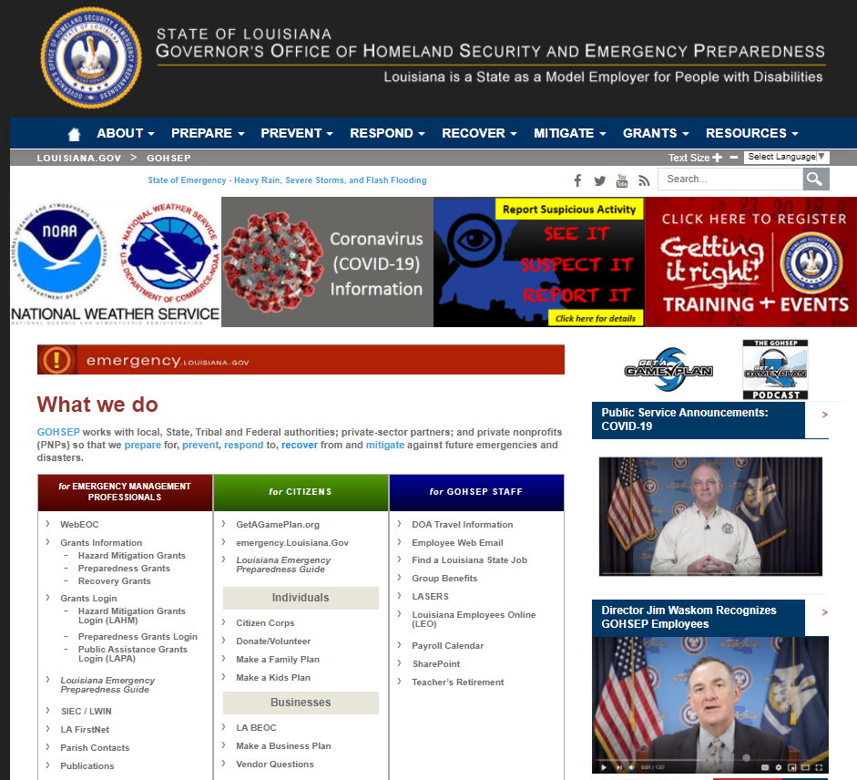
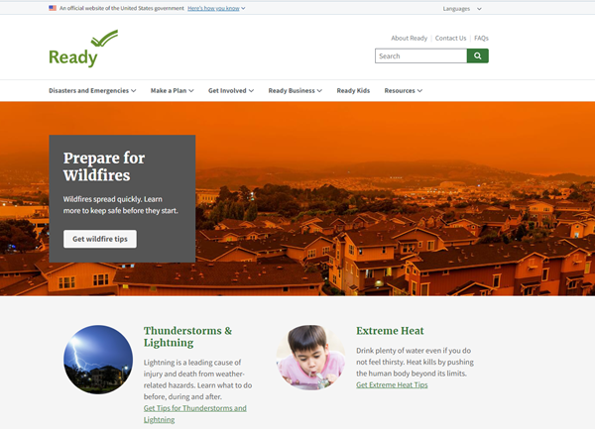
Resources
GOHSEP – gohsep.la.gov
FEMA – fema.gov
Get a Game plan – getagameplan.org
Emergency preparedness – ready.gov
  Individuals
  Businesses
  Finances

Slide 18
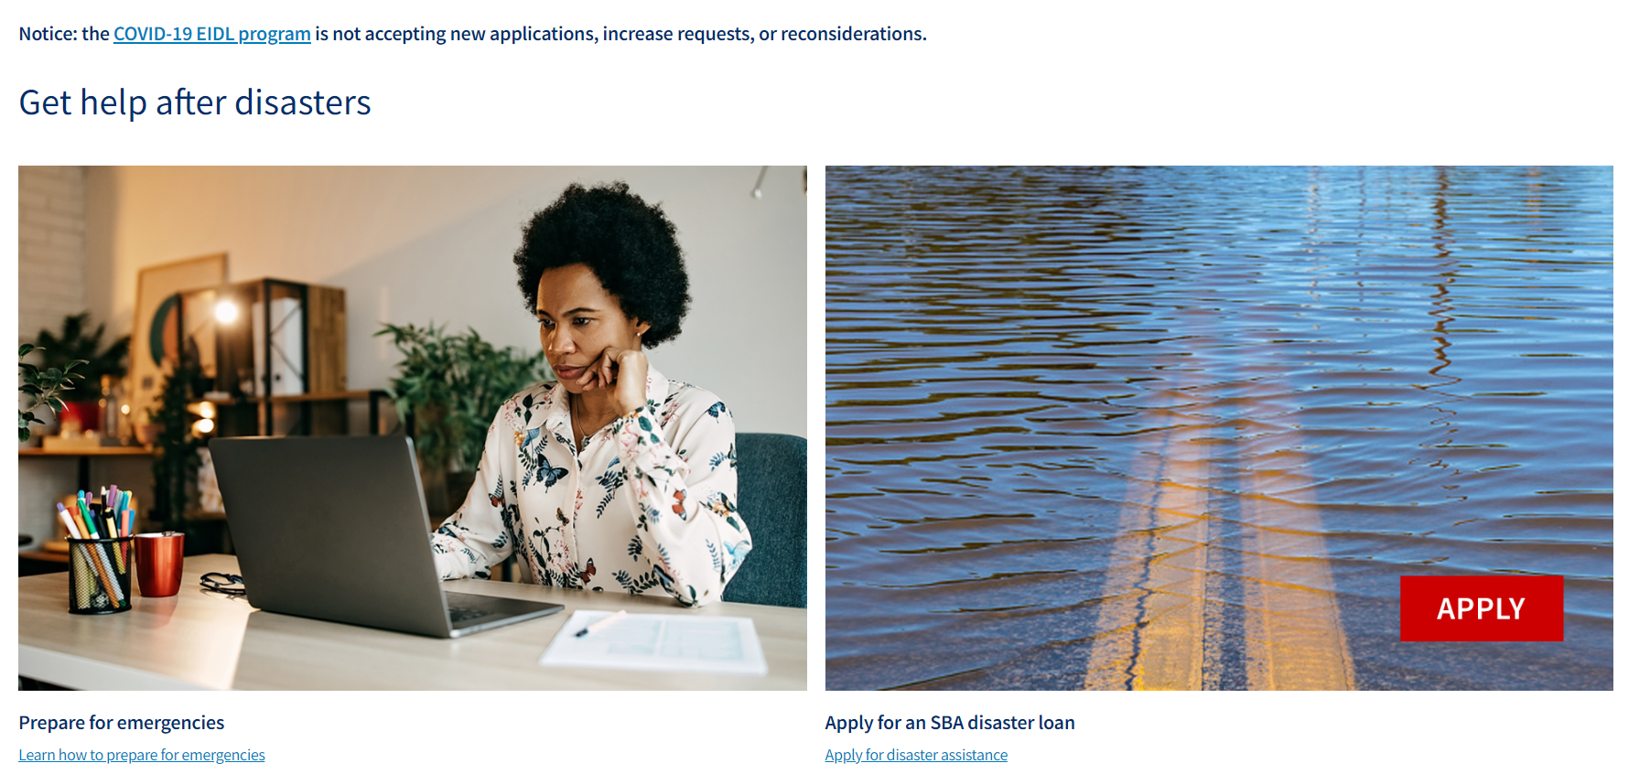
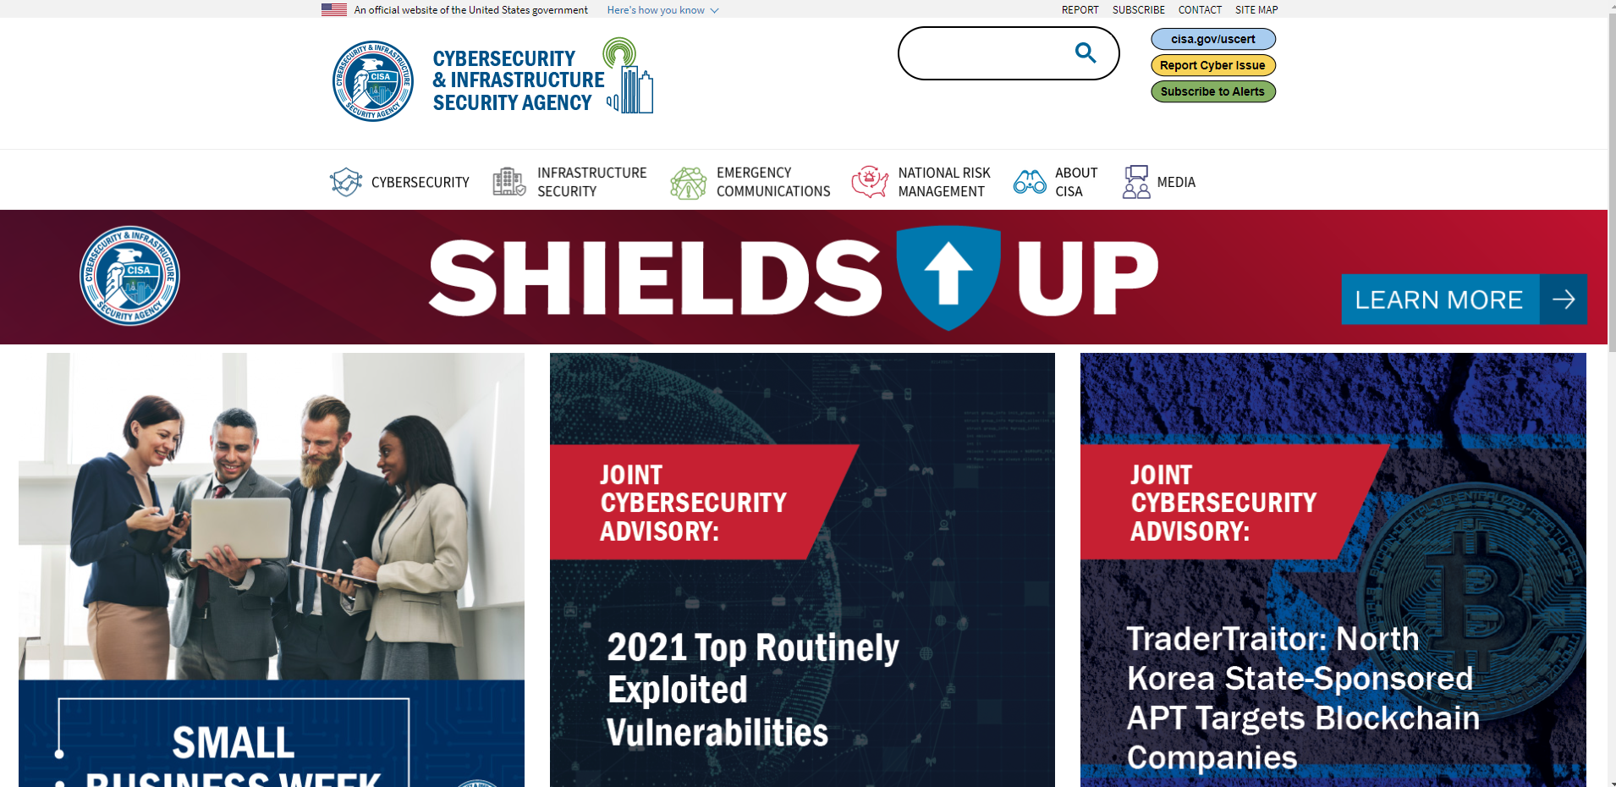
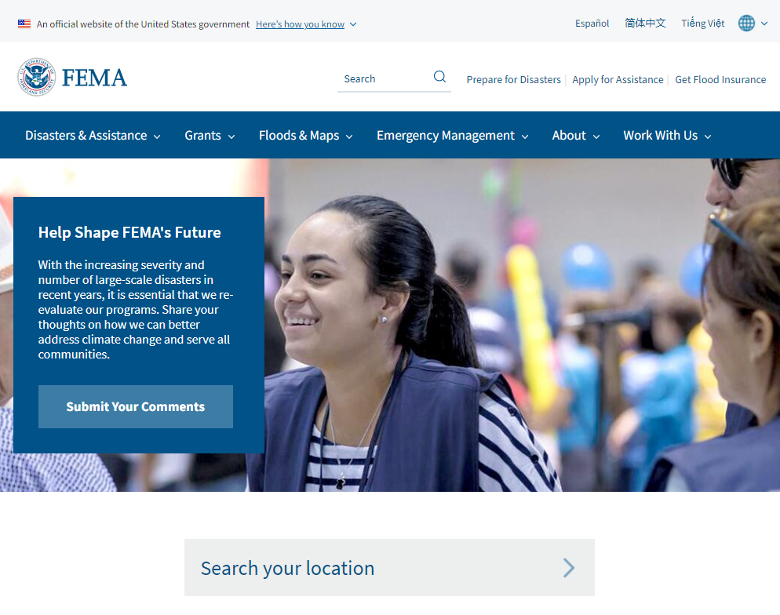
Resources
Small Business Administration (SBA) – sba.gov
Cyber Security & Infrastructure Security Agency – cisa.gov

Slide 19
QUESTIONS?

Slide 20
Jim Williams
Public-Private Partnership Operations Officer
Louisiana Business Emergency Operations Center
University of Louisiana at Lafayette, A Carnegie R1 Research University www.LABEOC.org james.williams@louisiana.edu
O: 337-482-0633

